Slide 1
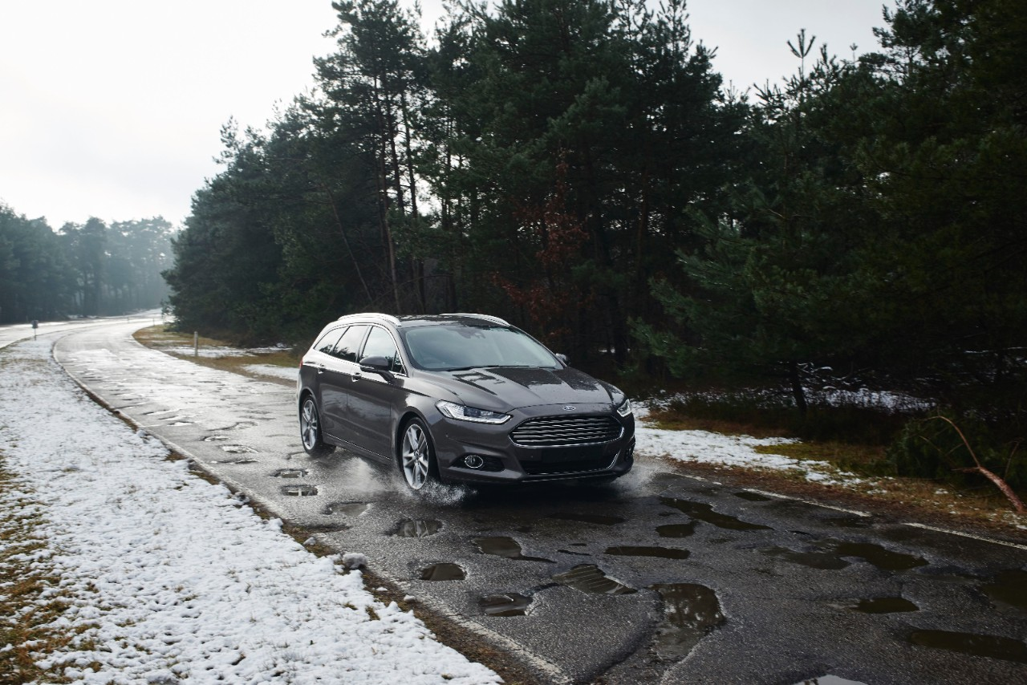

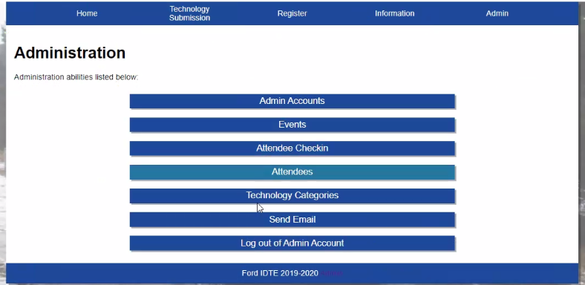
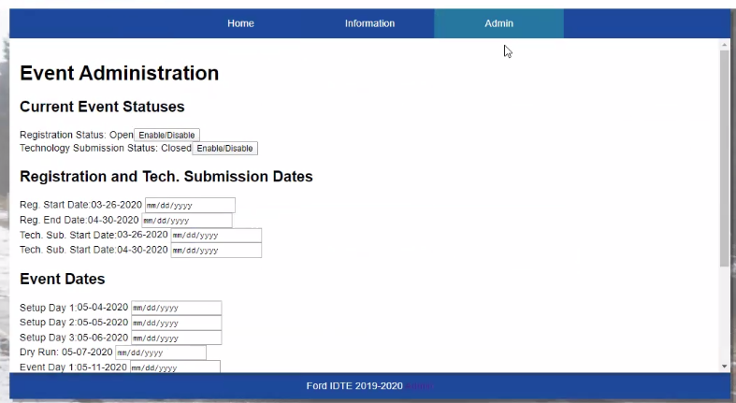
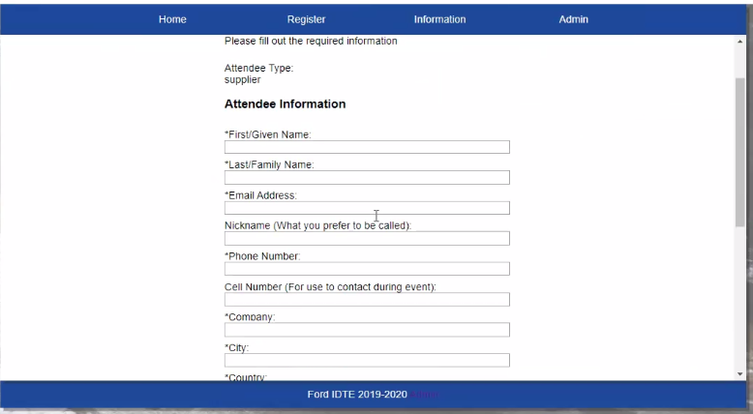
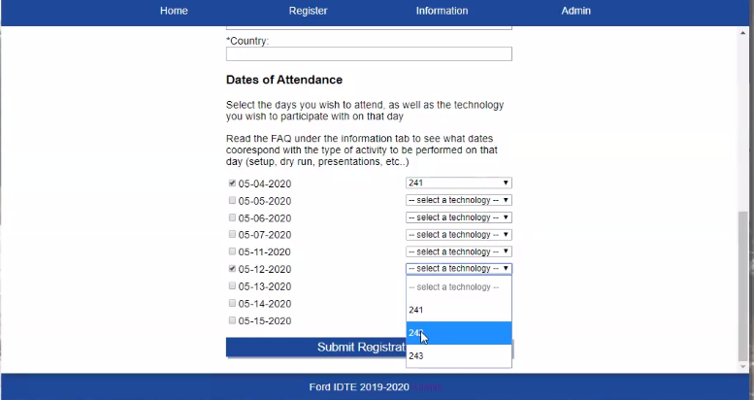
Make IDTE an EASIER event for registration
Team Members: Maxx Achtman
Chris Ciolek Nicholas Spencer Apolonio Cazares
Dr. Kiumi Akingbehin
Dr. Bruce Maxim
A view only Admins can see
Apply Registration Dates
What is IDTE?
IDTE stands for Innovation Drive and Technology Expo
Ford’s Event that allows new technologies to shine light to the company
IDTE is a yearly event held by Ford in Dearborn
Attendee Registration
Attend specific dates

